Slide 1
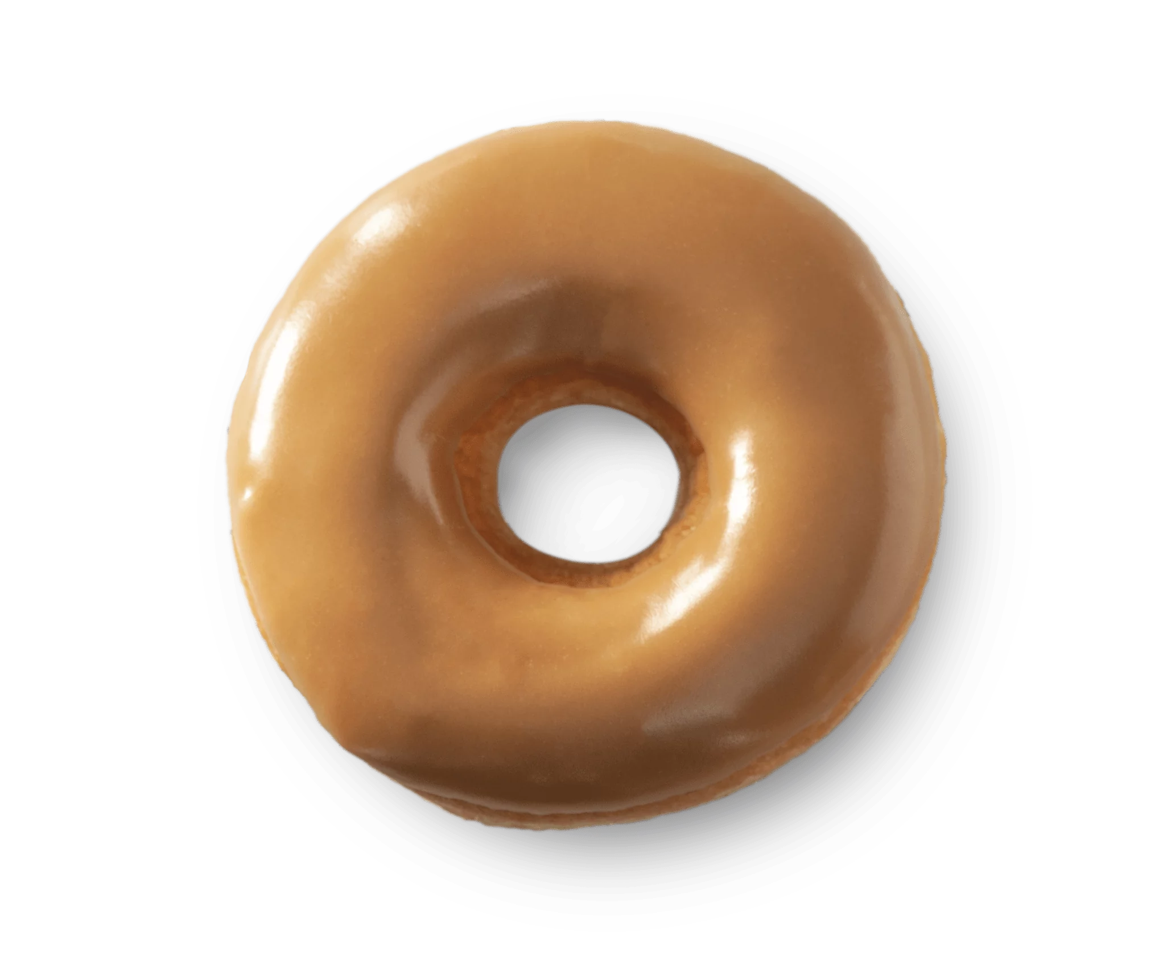

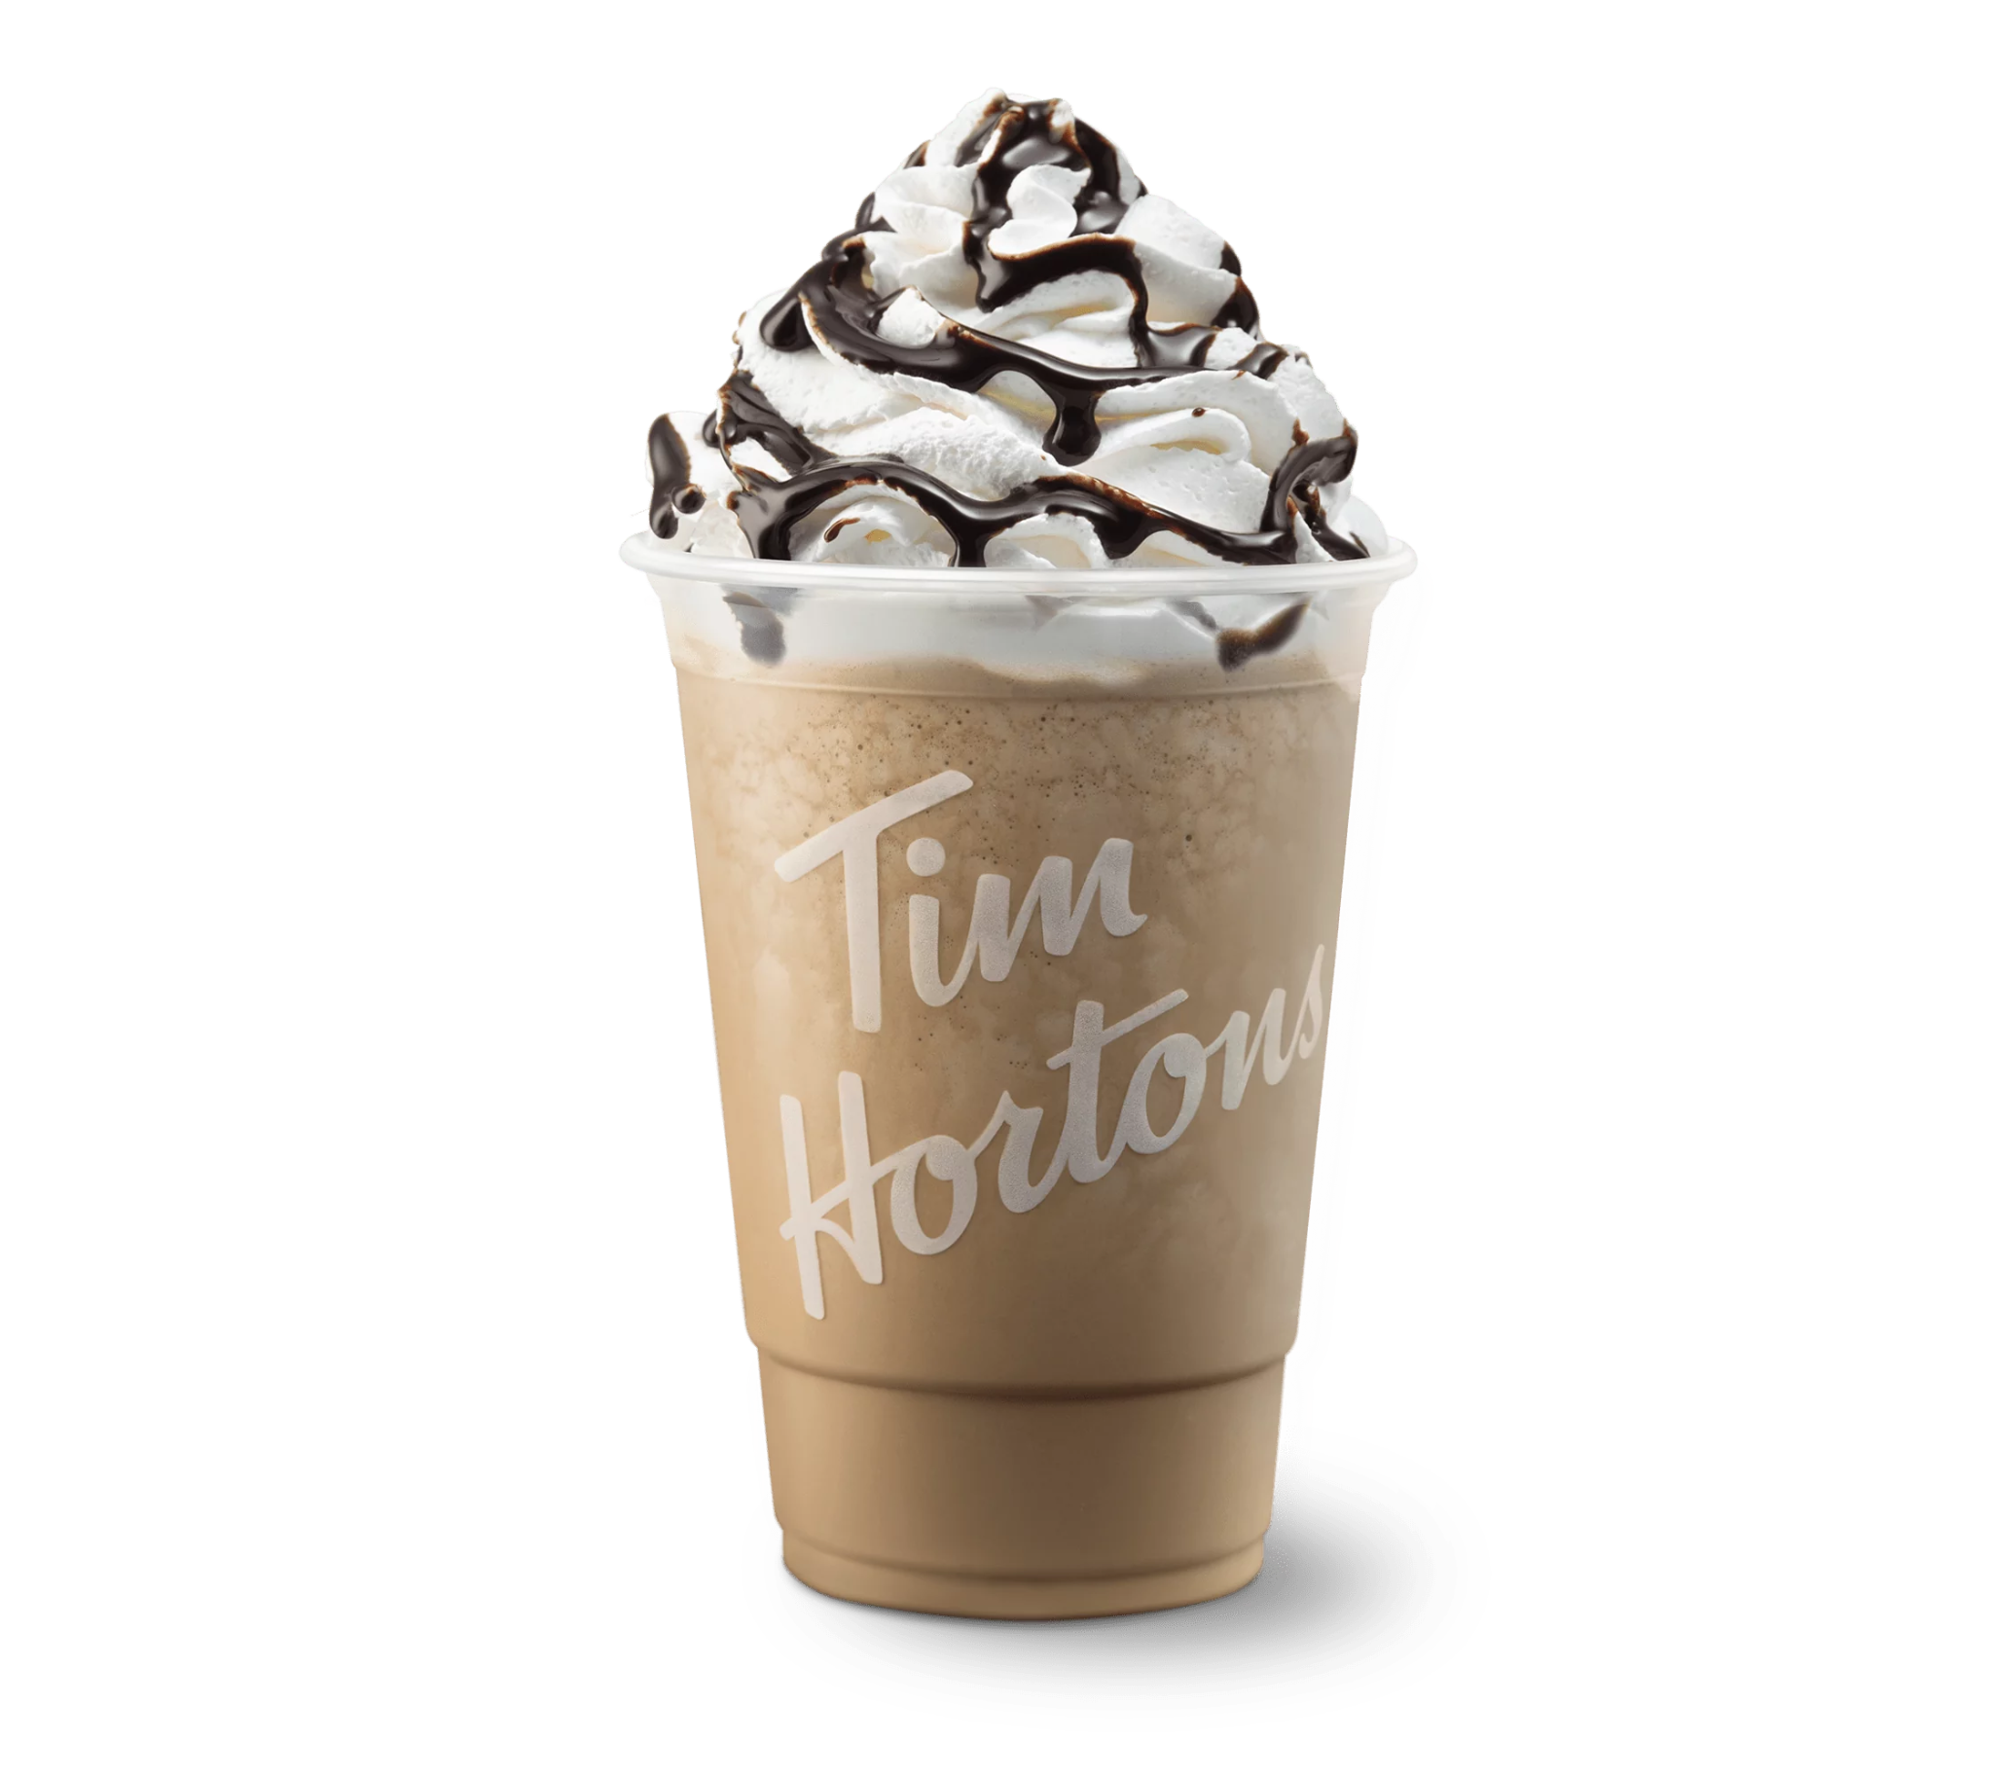



Tim Hortons
Queue System Simulation
Course: COMP 395 – Project 1
Group Name: Chomper Studios
Team Members:
Christopher Rojas
Denisjann Reyes
Yiu Yiu Yoyo Ho
Date: March 03 2025

Slide 2
Introduction
Objective:
To analyze the customer queue system at a Tim Hortons location using real-world data.
To develop a simulation in Unity that models queue efficiency.
To apply queueing theory and statistical analysis.
Why this Project?
Real-world problem with direct applications.
Understanding customer service efficiency in fast food chains.
Data-driven decision-making through simulation.
Notes:
How did your studio approach this project?
o
What tools did you use to stay on task?
o
How was work divided up amongst studio members?

Slide 3
Work Allocation
Yiu Yiu Yoyo Ho - Game System & Core Mechanics
Christopher Rojas - Game Environment & User Interface
Denisjann Reyes - Audio, Graphics & Additional Features

Slide 4
Original System (Real Tim Hortons Data)
Target Location: Tim Hortons, Centennial College - C Building - Marketplace
Operation Hours: 08:00 - 14:00 (Weekdays)
Observed Activities:
Customers arrive and join the line.
Customers reach the counter and place an order.
Customers receive their order and leave.
Key Observable Data:
Time of arrival, waiting time, service time.
Number of customers per 5-minute period.

Slide 5
Data Collection & Analysis
Observation Periods:
Feb 18, 2025 (10:15 - 11:00)
Feb 19, 2025 (12:45 - 13:25)
Key Metrics:
Average service time: X minutes
Average waiting time: Y minutes
Peak customer flow: Z customers/hour
Statistical Analysis:
Histograms with exponential curve fitting.
Probability distributions applied to waiting times.

Slide 6
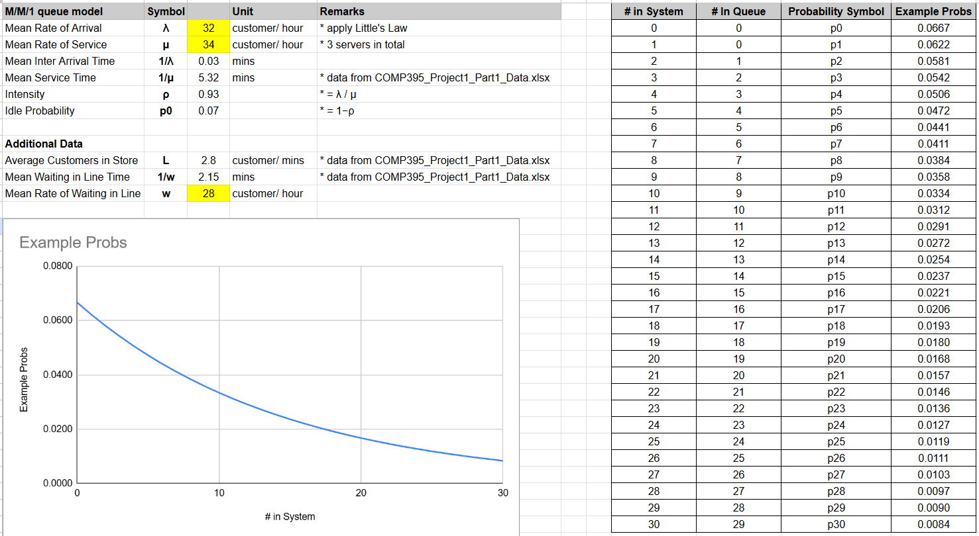
Excel Queue Simulation
Queueing Model Used: M/M/1 system.
Core Equations Used:
Probability of idle server:
Average customers in queue:
Time spent in premises:
Key Results:
Idle Probability: 7%
Average Customers in Queue: 12.36
Average Service Rate: 34 customers/hour
Graph: Probability of customers in the queue (0-30 customers)

Slide 7
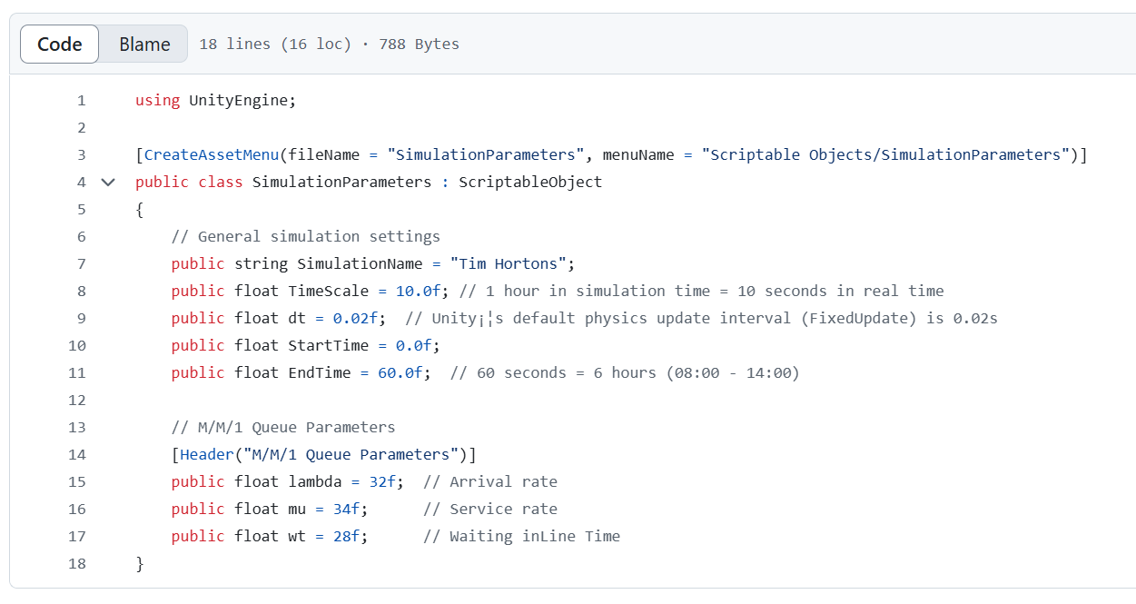
Simulator Parameter

Slide 8
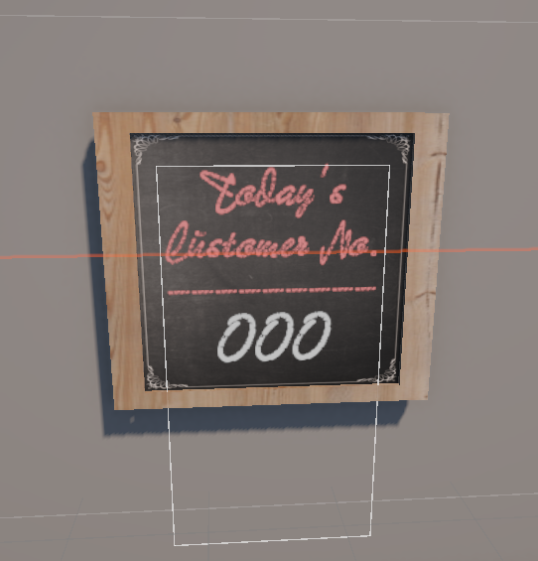
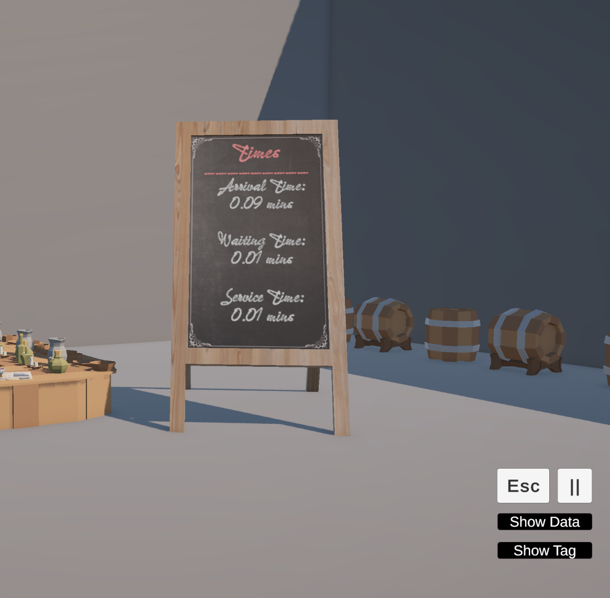
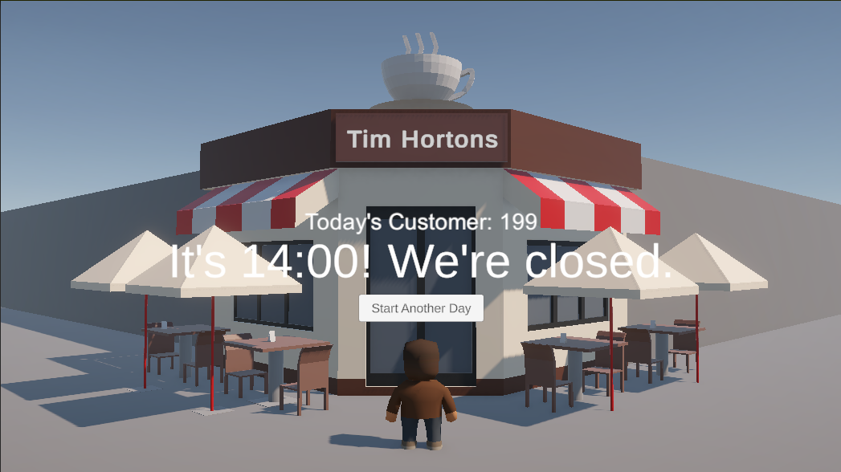
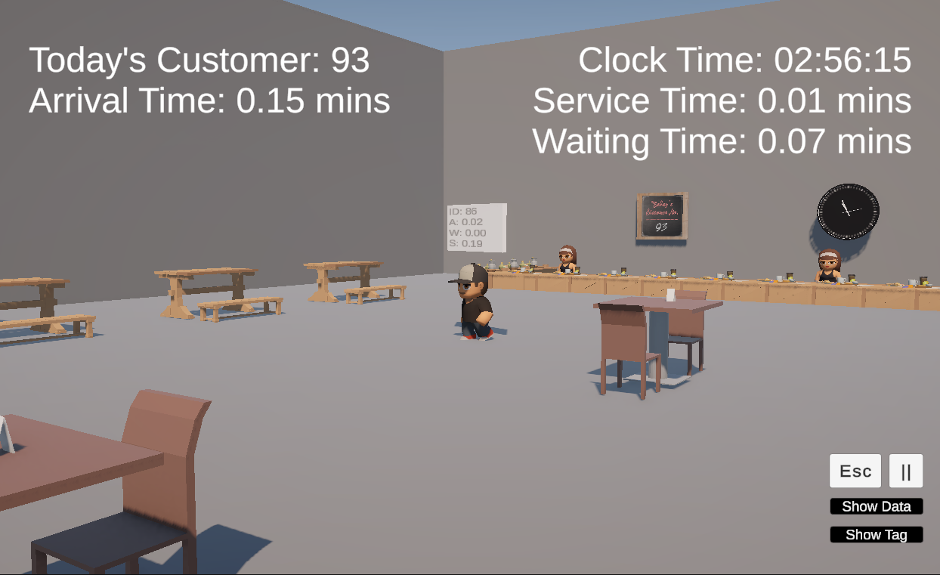
Unity Game Simulation
Features Implemented:
Clock Display: Simulated in-game time.
Notice Counter: Tracks total customers served.
Customer Data Panel: Shows real-time data (arrival, waiting, service times).
UI Elements: Pause, Exit, Show Data, Show Tags.
Simulation Speed: 6 hours simulated in 1 minute.

Slide 9
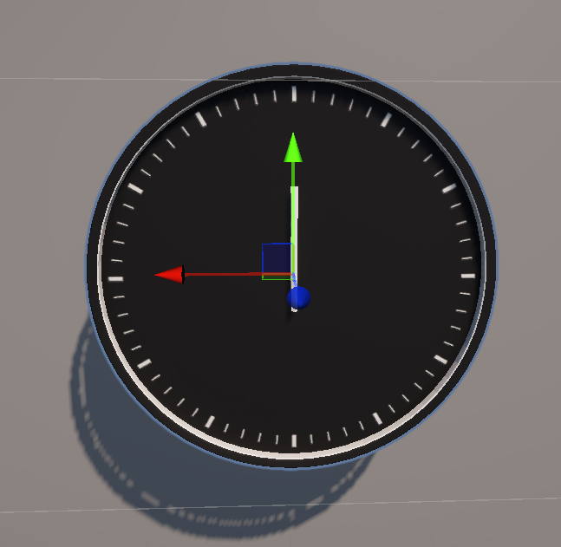
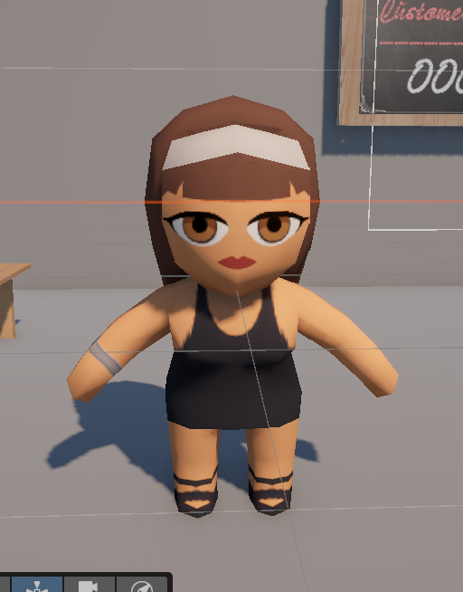
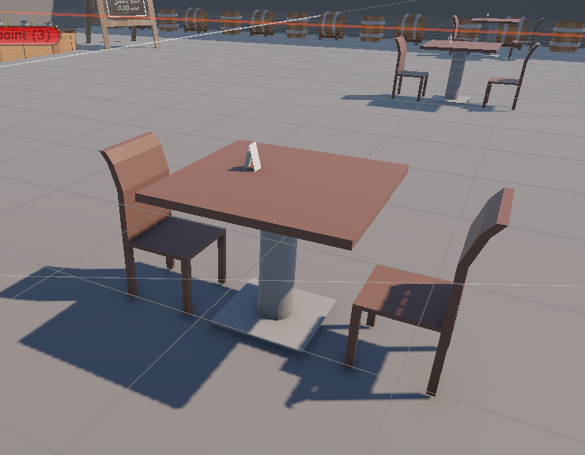
Game Design & Environment
Game Engine: Unity (C# Programming)
Assets Used:
BGM: Background music for immersion (jazz-cafe-music).
Simple Café: Environmental assets for the café.
Toony Tiny People: Character models for customers and staff.
Clock & Signage: UI elements representing time and queue metrics.
Camera & Rendering:
Isometric view.
2D/3D hybrid system for clarity.

Slide 10
Results & Analysis
Queue Efficiency Findings:
Peak congestion times identified.
Average waiting time within expected range.
Server utilization rate balanced.
Comparing Excel Model & Unity Simulation:
Both models show consistent results.
Real-time adjustments in Unity add extra insights.

Slide 11
Challenges & Future Improvements
Challenges Faced:
Data collection limitations (sample size constraints).
Balancing realism and computational efficiency in Unity.
Adjusting AI behavior for accurate queue representation.
Future Enhancements:
Adding AI-driven customer behaviors.
Implementing dynamic employee shifts.
Implementing a heatmap visualization for peak queue times.

Slide 12
Demo

Slide 13
Thank You!

